Slide 1


Slide 2
Subtopics
Concept:
stream, bytes, architecture File + directory
organisation, path (relative+absolute)
functions
Normal FH
open, read (line and specific number of char), write
difference between modes
with
split files
Application
Generic
Steg

Slide 3
Always remember:
No one is born with a keyboard in their hand; It’s only human to make mistakes;
and There are no dumb questions.

Slide 4
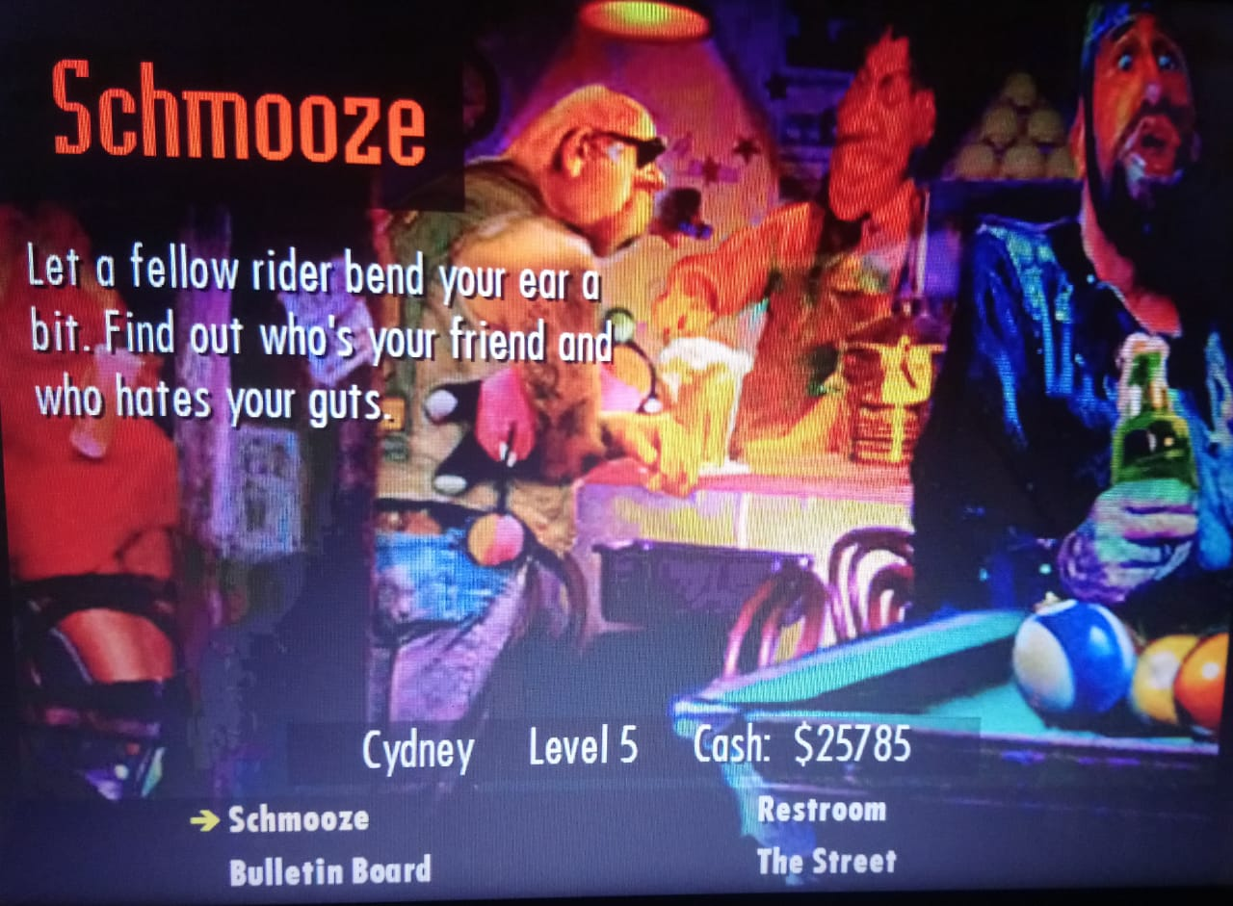

Slide 5
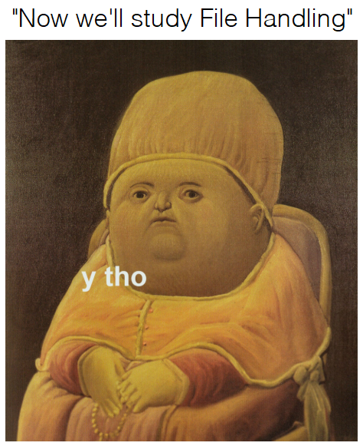

Slide 6
Difference between Streams and Files
Programmer (user)
Stream (Interface)
Device (File)
FILE: Device ON which an action is to be performed; may be anything.
STREAM: Interface BETWEEN the user and the said device; independent of the device being accessed.

Slide 7
Directory Structure
Organisation
Path
Directories/Volumes

Slide 8
write
read
lstrip
rstip
with
Functions for File Handling
split
open
close
seek
tell

Slide 9
getcwd
mkdir
Directory-related functions
rmdir
chdir

Slide 10


Slide 11
open()
objectName = open(fileName, mode);

Slide 12
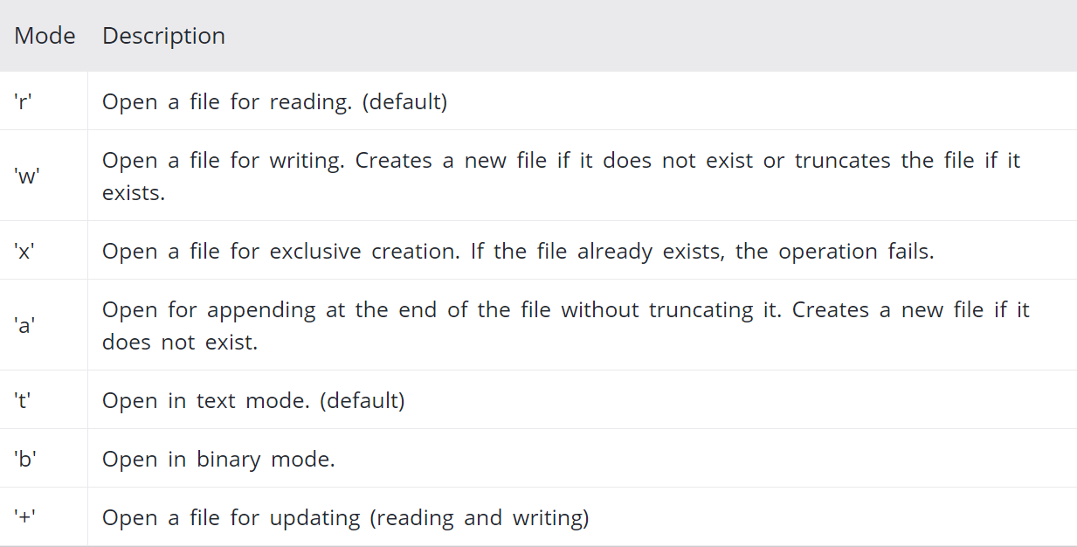
Modes

Slide 14
someAction()
objectName.someAction()

Slide 15
Where
someAction can be:
close read readLine write

Slide 16


Slide 17
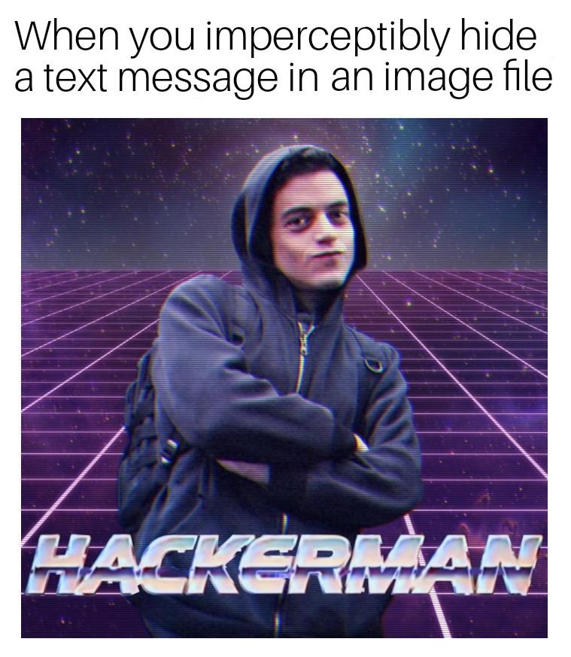

Slide 18
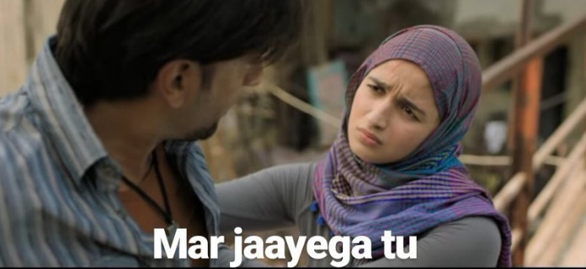

Slide 20
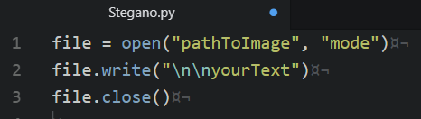

Slide 21
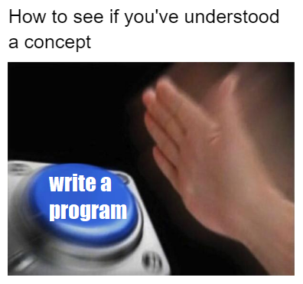

Slide 22
Now try something that you do everyday (slides 22-24):
Make a simple text file using Python, named YOUR_ASSIGNMENT.txt. (Hint: it is a new text file, and you will write to the file.)

Slide 23
Write characters in the file (can be anything)
Now, we want to copy the contents of YOUR_ASSIGNMENT.txt to another file called MY_ASSIGNMENT.txt.
As is obvious, you’ll have to create YOUR_ASSIGNMENT.txt.
(Hint: To copy, YOUR_ASSIGNMENT.txt shall be opened in input mode, and writing to MY_ASSIGNMENT.txt will require it to be opened in output mode)
(Ask us if you still have any doubts)

Slide 24
Open MY_ASSIGNMENT.txt and display its contents.
Check if YOUR_ASSIGNMENT.txt has been copied correctly.

Slide 25
The answer for the question mentioned in slides 22-24 is given in the file named SampleProgram.py.
(If your code differs, as long as the basic aim of the aim of question is addressed you don’t need to worry.)

Slide 26
These are some sites that had been referred to for this topic:
Read further if you’re interested.
If you aren’t, don’t ¯\_(ツ)_/¯
(I hope) you now know whatever basics you need to.
https://www.w3schools.com/python/python_file_open.asp
https://www.geeksforgeeks.org/file-handling-python/
https://www.tutorialspoint.com/python/python_files_io.htm
https://www.programiz.com/python-programming/file-operation
https://www.pythonforbeginners.com/files/reading-and-writing-files-in-python
https://www.pythonforbeginners.com/cheatsheet/python-file-handling

Slide 27
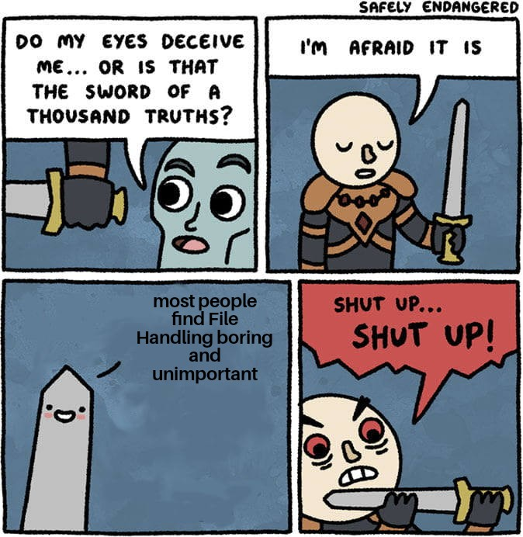

Slide 28

Thank you for PAYING attention in this free workshop.

